Slide 1


Life of Corona Chan
A Real Contributor

Slide 2

Introduction
Wuhan ,China
Dec, 2019 (age = 9 months)
Bats and Pigs
Chinese Citizen
Wuhan Institute of Virology
Born :
Parents : Nationality : Alma mater :

Slide 3

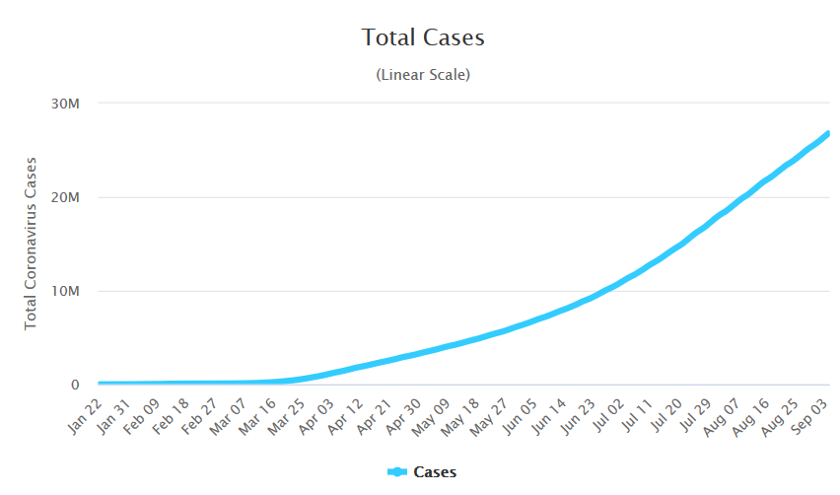
Journey as a young Entrepreneur
Age 1 month – 15000 people got subscription.
Age 3 months – 500k people got subscription.
Age 6 months - 1 Crore got subscription.
Age 9 months - 2.5 Crore got subscription.

Slide 4
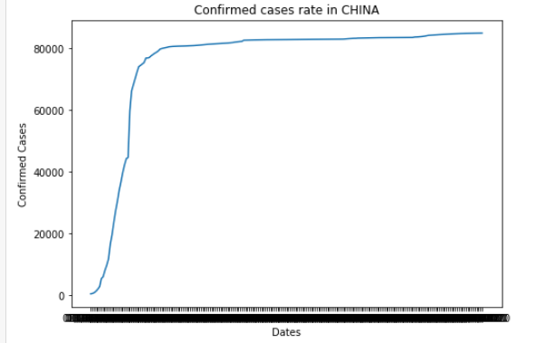
Corona as a Startup

Slide 5

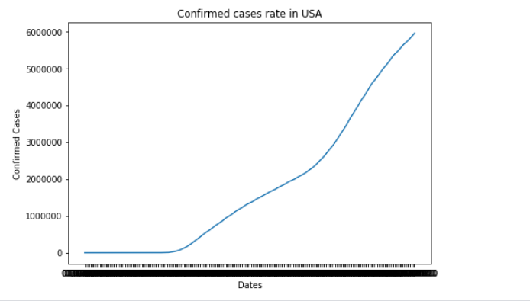
Business Expansion

Slide 6
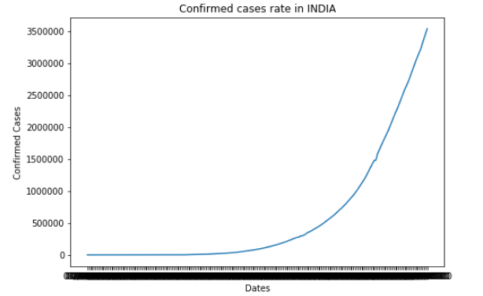
Make in India : Real Crush

Slide 7
Summary
Overall, there have been over 19.7 million confirmed subscribers.
Number one entrepreneur in the whole world

